Slide 1
Design:Proficient

Slide 2

Table of content
At the end of this course, the participants should be able to:
Design a small network of sub-components
While understanding and using the concepts around
Multi-threading
Portability
Interface Design
Performance

Slide 3
Design-Proficient
Design
In this session, each one of you needs to update a design document!
Exercise
mixed with
Knowledge

Slide 4
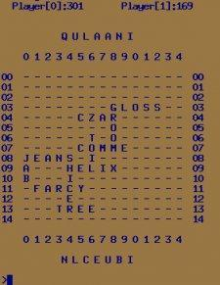
DeSIGN - Proficient
Online Multiplayer Scrabble (OMS) Server
Notes:
10 minutes:
Discuss the definition of design
Wikipedia says “Software design is the process by which an agent creates a specification of a software artifact, intended to accomplish goals, using a set of primitive components and subject to constraints”.
It is the blueprint of how a software needs to be implemented.
Encourage the participants to discuss what happens if we don’t have a design phase and get into coding straight away.
For small activities like Coding a search algorithm, it may be easy to code directly, but if you want to implement a larger system, while making sure that all its requirements are satisfied (and that others are ok with your approach), it makes more sense to make a design document first.
Design helps organize your thought process before coding.

Slide 5
DeSIGN - Proficient
OMS features
Multiple games
Ascii text based games , no GUI
Each game with 2-4 players
Online update
New user connects to Game Server and registers
This port can also be used to drop from game or start afresh
New user can choose between 2 and 4 player games
If enough awaiting users are available, new game launched
Else user is asked to wait in a queue
In the game, response needs to be given in 30 seconds else points deducted

Slide 6
DeSIGN - Proficient
Main components of Server
User Manager
User list
Game Manager
Game updates
Connection mgt response
Game view/Game control messages
Connection management inputs
Player inputs
Network Layer
Game messages
Player n
Connectivity messages
Notes:
Discussion: 10 minutes
The participants need to develop the protocol decoder

Slide 7
DeSIGN - Proficient
User Manager
What can be the main functionalities of the User Manager
Managing new user requests and wait queue
Manage status of existing users
Launch game
Lets analyze each point

Slide 8

DeSIGN - Proficient
User Manager
Managing user requests
How will the new users reach out to Game server?
User Manager
User list
Game updates
Connection mgt response
Need for a well known port
Need to define a message format
Interface between Network Manager and User Manager
Queue? UDP?
Connection management inputs

Slide 9
DeSIGN - Proficient
User Manager
Managing status of awaiting users
How is the awaiting user list maintained?
Queue to store user information (what will be the user information?)
Everytime a new user request comes in, preferences are compared (2 user game or 4 user game)
If the match is found, launch game
Remove the selected users from the queue

Slide 10
DeSIGN - Proficient
User Manager
Launch game?
Once a match is found, how to launch the game?
How is the Game Manager manifesting itself?
Process?
Thread?

Slide 11

DeSIGN - Proficient
Exercise
What are the main components of your design?

Slide 12
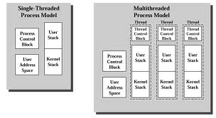
DeSIGN - Proficient
Threads
A thread:
Exists within a process and uses the process resources
Has its own independent flow of control as long as its parent process exists and the OS supports it
Duplicates only the essential resources it needs to be independently schedulable
Share the process resources with other threads
Dies if the parent process dies - or something similar
Threads - Shared Memory Concurrency
Concurrent execution flows share address space

Slide 13
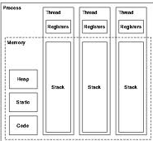
DeSIGN - Proficient
Threads
Advantages of sharing address space
Thread Switching time overhead is smaller
Memory address mapping need not change at MMU when you switch threads on the CPU from the same process
Threads inside a process are able to communicate faster with each other through shared data area
Has the potential to improve the performance
One can use multiple CPUs and I/O devices in parallel using threads
Disadvantages
It is easy to create conflicts between two threads of the same process
Race conditions and deadlocks
Performance of the system can degrade if not used effectively

Slide 14
DeSIGN - Proficient
When to / not to use threads
Ask yourself some of these questions to figure out whether to use threads or not
Is the application I/O bound ? If the application has following structure you will benefit from converting it to a multithreaded application
Original Application
compute --- wait for i/o --- compute --- wait for i/o
Multithreaded Application
Thread 1 - compute --- wait for i/o --- compute --- wait for i/o
Thread 2 - wait for i/o --- compute --- wait for i/o --- compute
Does the application have pieces – which are more or less independent of each other and you have a multiprocessor machine
e.g. – call processing for separate calls on a switch
Call processing for different calls are generally independent of each other though there is some resource contention between them

Slide 15
DeSIGN - Proficient
When to / not to use threads
Are you designing an user-interface
It is generally recommended that you create threads to handle different operations and always provide the user the opportunity to interact with the tool/application
Without threads, such programs would freeze when presented with a long operation and the user may not feel good about it.
By having multiple threads you may allow the user to even cancel the operation, which will not be possible otherwise
Program structure
Some programs have a nice parallel structure
Example can be of a Network Management entity to monitor multiple devices/nodes may have independent threads to monitor each of these devices/nodes
Do not use threads where you have compute bound algorithms and you have a uni-processor machine
Do not use threads where there are lot of dependencies between threads
It will create a very complex program and because of complex interactions the performance will also suffer

Slide 16
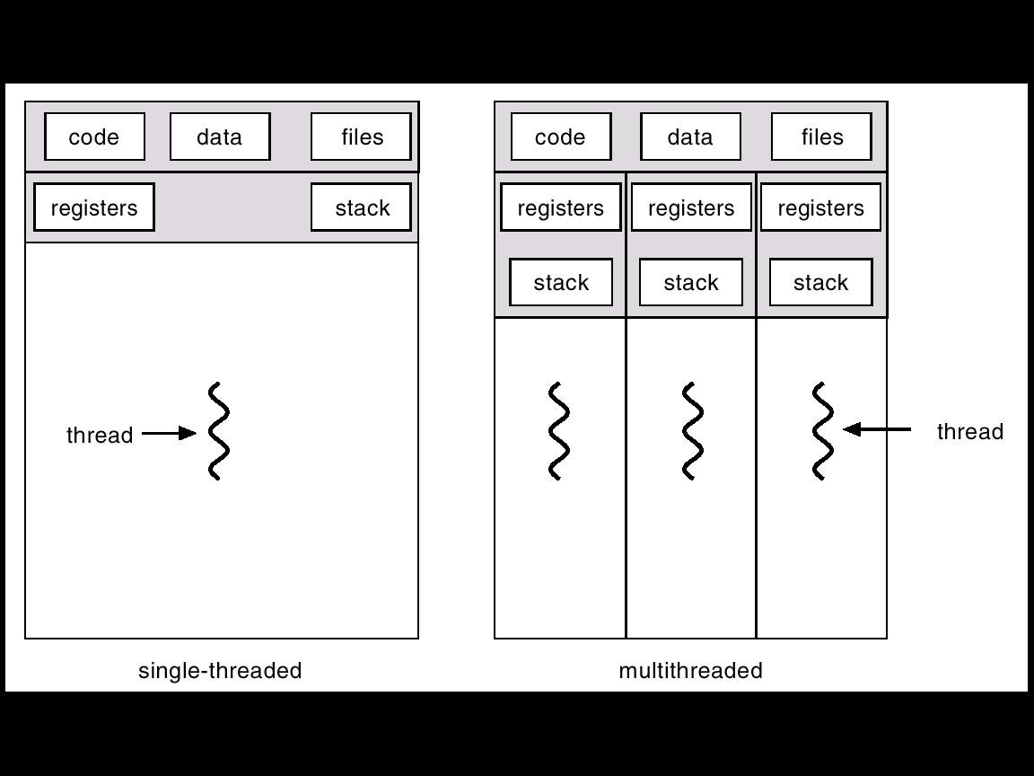
DeSIGN - Proficient
Multi-threaded Concurrency
Supporting Multiple Users Simultaneously…
Thread
A sequence of instructions executed within the context of a process (a control point traversing an address space)
Multi-threaded Process
Notes:
A comparison with forked concurrency could be brought in

Slide 17
DeSIGN - Proficient
User Manager
Launch game?
Once a match is found, how to launch the game?
How is the Game Manager manifesting itself?
Process?
Thread?
Concurrency – is there any common piece of data which needs to be locked?
Thread created for a new game once the participants of the game are finalized. User list is the parameter to the launched thread
This thread directly interfaces with the players
Concurrency – common data includes
Dictionary – (read only)
User statistics – can be relayed to User Manager Thread via an IPC
So no real need for locking in this case

Slide 18
DeSIGN - Proficient
Exercise
What suits your design best?

Slide 19
DeSIGN - Proficient
Thread Models
The boss/worker model
The peer model
The pipeline model

Slide 20
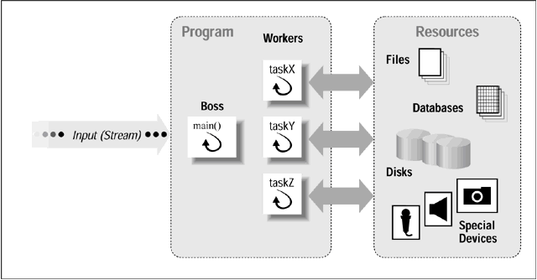
DeSIGN - Proficient
Boss/Worker Model
Notes:
A single thread, the boss, accepts input for the entire program. Based on that input, the boss passes off specific tasks to one or moreworker threads. The boss dynamically creates a new worker thread when it receives a new request.

Slide 21
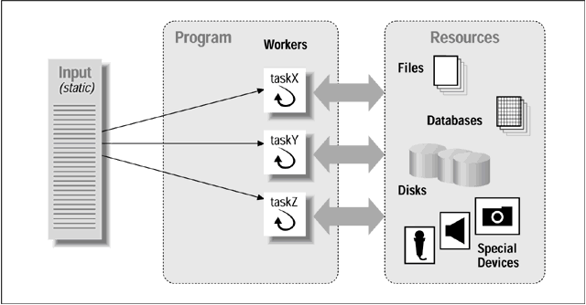
DeSIGN - Proficient
Peer Model
Notes:
In the peer model, also known as the workcrew model, one thread must create all the other peer threads when the program starts. However, unlike the boss thread in the boss/worker model, this thread subsequently acts as just another peer thread that processes requests, or suspends itself waiting for the other peers to finish.Whereas the boss/worker model employs a stream of input requests to the boss, the peer model makes each thread responsible for its own input. A peer knows its own input ahead of time, has its own private way of obtaining its input, or shares a single point of input with other peers

Slide 22
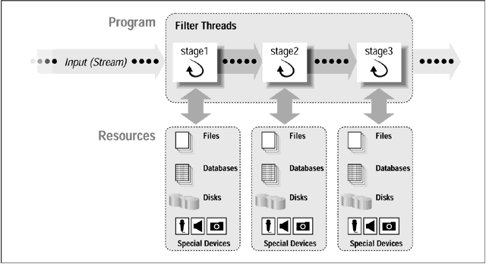
DeSIGN - Proficient
Pipeline Model

Slide 23
DeSIGN - Proficient
Discussion
What are the disadvantages of
The boss/worker model
The peer model
The pipeline model
How can we overcome them?
Notes:
This can be a 15 minute discussion
Analyse in terms of performance, scalability, race conditions, manintainability

Slide 24
DeSIGN - Proficient
User Manager + Game Manager
Which is the best model to use?
The boss/worker model
The peer model
The pipeline model
Boss/Worker Model
The User Manager can be the Boss thread which launches a Game Manager thread(Worker) for every new game.

Slide 25
DeSIGN - Proficient
User Manager + Game Manager
Main thread
(User Manager )
Game 1 thread
Game status
Game 2 thread
Launch thread (used IDs)
Game 3 thread
Data shared
Game details is local to the game thread.
Only user information needs to be shared
Interface – how will these threads communicate with the players?

Slide 26
DeSIGN - Proficient
Exercise
Which model would you choose?
Update the design doc

Slide 27
DeSIGN - Proficient
Portability – a quick review
Platform specific code
Core Code
The core code will speak to the outside world via the outer shell. Platform dependant code is limited to this shell.
Call system APIs via an abstract wrapper function.
Use data types via a wrapper data type (typedef)

Slide 28

DeSIGN - Proficient
Portability
Portability issues to address
Memory Management
Timer Management
IPC mechanism
Thread and Locking mechanism
Big Endian/Little Endian
Size of a Data type
Network management
Notes:
Porting is the process of adapting software so that an executable program can be created for a computing environment that is different from the one for which it was originally designed
Demonstrate the embedded “portable code” – Execute the same!
Comment the “htons(port)” (line 38) from “daytime_server.c” and demonstrate again
Discuss network level portability based on this

Slide 29
DeSIGN - Proficient
OMS
Porting is the process of adapting software so that an executable program can be created for a computing environment that is different from the one for which it was originally designed
Demonstrate the embedded “portable code” – Execute the same!
Comment the “htons(port)” (line 38) from “daytime_server.c” and demonstrate again
Discuss network level portability based on this

Slide 30
DeSIGN - Proficient
Exercise
Which portability aspects are applicable to your modules?
Any commonality?
Update the design document

Slide 31

DeSIGN - Proficient
Performance
Key considerations
Buffer management
Zero copy
Pre-computing

Slide 32
DeSIGN - Proficient
Performance
Buffer management strategy must address:
Formation of the buffer area or buffer pool
Allocating buffers from and releasing buffers to the buffer pool
Minimizing data copy between buffers and between different protocol components
Debugging aids

Slide 33
DeSIGN - Proficient
Performance
Zero copy
Using pointers to data rather than copying data
Smart encoding - The first protocol layer that generates a packet must leave enough room at the beginning for further layers to prepend headers. Doing so allows further protocol layers to add their headers without having to copy the entire packet into another buffer
Across processes, shared memory can be used
Points to note around copying
To avoid blocking or reentrancy issues, important to break communication flow – dump data onto a buffer/queue. Then copy may be required
Memcpy vs strcpy – strcpy is not useful why copying binary data

Slide 34
DeSIGN - Proficient
Performance
Pre computing
While encoding pre-compute headers instead of generating them every time
Look out for repetitive computing and pre-compute

Slide 35
DeSIGN - Proficient
Performance vs scalability
A scalable system does not imply high performance
The performance should be consistent irrespective of scale
Scalability issues
Limited queue sizes (platform dependant)
Too many queues – will spend more time checking for data across all of them
Large arrays used, traversal all across arrays in consecutive steps
Page faults
Cache miss

Slide 36
DeSIGN - Proficient
Performance - OMS
Potential bottlenecks for OMS
Timely sharing of updated game views with all players
Should we share entire table every time or only updates?
Player module should be Thin client or thick client
Zero copying
Upon receiving the new word (string), avoid copying the string
De-reference using pointers.
Dictionary lookup via ternary trees
User Manager thread as a bottleneck
If load increases, should we create one more thread

Slide 37
DeSIGN - Proficient
Exercise
Isolate and list the core functionality and the functionality which should be in the Port module.

Slide 38
DeSIGN - Proficient
Interface Design
Interface design considerations
Mode of communication
Event synchronization
Message priority
Type of communication
Loosely Coupled Message Communication (Asynchronous)
Tightly Coupled (Synchronous) Message Communication With Reply
Tightly Coupled (Synchronous) Message Communication Without Reply
IPC to be used

Slide 39
DeSIGN - Proficient
Interface design
Loosely Coupled Message Communication (Asynchronous)
The Producer sends message and continues without waiting for response, Consumer receives message.
As the produce and consumer tasks proceed at different speed, a FIFO message queue can build up between producer and consumer.
If there is no message available when the consumer requests one, the consumer is suspended.

Slide 40
DeSIGN - Proficient
Interface design
Tightly Coupled (Synchronous) Message Communication With Reply
Producer Sends message, and Waits for reply,
Consumer is activated when message arrives and accepts message, process it, generates a reply, and then send the reply.
The producer & consumer the both continue.
If the consumer suspended if there is no message is available.

Slide 41
DeSIGN - Proficient
Data Modeling
Tightly Coupled (Synchronous) Message Communication Without Reply
Producer Sends message & waits for acceptance by Consumer
Consumer Activated when message arrives, Accepts message, there by releasing the producer.
The Producer and Consumer continue.

Slide 42
DeSIGN - Proficient
OMS
Main thread Interface with Network layer
Asynchronous – player input can come anytime
Packet size depends on length of word
Assume scrabble board can support a word of max 10 letters – so it is fixed
Use message queues
One queue to receive control information (user registration, termination)
One queue for receiving player inputs
One UDP interface to send game updates to players

Slide 43

DeSIGN - Proficient
Exercise
For given partially filled design document
Update interface design and flow
Update wrapper interface
Fix the message encoding design for performance

Slide 44
Disclaimer
Aricent Group makes no representations or warranties with respect to contents of these slides and the same are being provided “as is”. The content/materials in the slides are of a general nature and are not intended to address the specific circumstances of any particular individual or entity. The material may provide links to internet sites (for the convenience of users) over which Aricent Group has no control and for which Aricent Group assumes no responsibility for the availability or content of these external sites. While the attempt has been to acknowledge sources of materials wherever traceable to an individual or an institution; any materials not specifically acknowledged is purely unintentional

Slide 45
Revision History
Revision no. | Date | Description of change | Author | Reviewed and Approved By
0.1 | 31-dec-13 | Initial set | Shiv Kumar
0.2 | 10-Jan-13 | Updation for correcting sequence | Shiv

